Slide 1
HCHD Board Report
July 22, 2021

Slide 2
Project Officer Report
Prepared for the HCH District Board
05/27/2021

Slide 3
VCLC Updates
Vaccination Rates:
Fitzsimons- Staff 92.2%, Residents 96.5%
Florence- Staff 85.7 %, residents 92.6%
Homelake- Staff 67.5 %, residents 97.1%
Rifle- staff 65.7% , residents 95.7%
Spanish Peaks- staff 69%, residents 98%

Slide 4
VCLC Updates
We have begun to operationalize our needs assessment findings.
The areas we are focusing on to start are:
Revenue Collection
Admissions Process
Marketing Strategy
Service Planning Registry
Behavioral Health

Slide 5
VCLC Updates
The OSA Audit has continued consistently. They will send out requests to the VCLC’s through Elizabeth Mullins and send clarifying questions for the VCLC to answer.
They continue to look into infection control as it relates to COVID19.

Slide 6
Kelsie Heermans, Project Officer
kelsie.heermans@state.co.us
303-909-5142

Slide 7
CEO Report
Kay Whitley

Slide 8
Updates
SVH Virtual Survey – June 22, 2021
Received results 07/21
Three (3) deficiencies
Kansas Building (Closed)
Family Planning – Ambulance Conference room/offices
Women’s Health - RHC
*RTA will send a final report for Kansas Bld. and Ambulance Barn this week.
Capital projects underway:
Resident room furniture (VCLC and ECU) – RTA interior designer
Dining room tables (VA grant)
Parking lot

Slide 9
COVID -19
We have administered 2025 COVID vaccines.
We are holding our last vaccine clinic in the hospital this Friday 7/23.
Vaccine clinic will be moving to the clinic (RHC).
Employee COVID vaccine rate:
#1- 222/301 73.75% (74%)
#2 or complete 216/301 71.76% (72%)

Slide 10
Strategic Planning Work Session
September 14th
0730-1:00
Agenda: revisit plan and determine next steps.

Slide 11
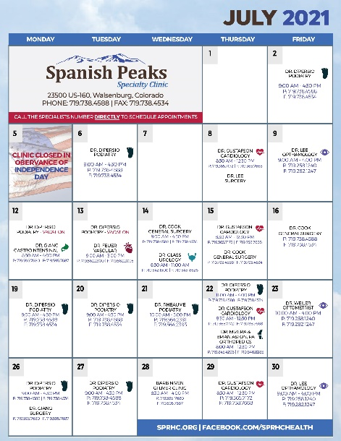
REBRANDING
FLYERS
BROCHURES
NEWSPAPER ADS
POSTERS
SIGNS
VEHICLE GRAPHICS
LETTERHEAD
BUSINESS CARDS
ENVELOPES
FORMS

Slide 12
SOCIAL MEDIA
28 DAY TOTALS: TOTAL POST VIEWS: 14,147 | TOTAL POST ENGAGEMENT: 2,745 | TOTAL PAGE VIEWS: 367

Slide 13
ANHA Report
Teresa Clift

Slide 14
NH Update
Census 69 as of 7/21/2021 – several pending admissions
Admissions update
25 new admissions (2 respite) since January 1, 2021
OSA Audit
CNA Class – starting August 2nd
Resident’s Council
2nd in person meeting in 18 months
Good attendance and feedback from residents
Vaccine data
Residents 99% fully vaccinated
Staff – 73.58% - 1st dose, 69.8% fully vaccinated

Slide 15
Applications due by 7/28/2021
Interviews on 7/29/2021
Class starts 8/2/2021
Candidate must complete the training program, pass the exam and commit to one year employment

Slide 16
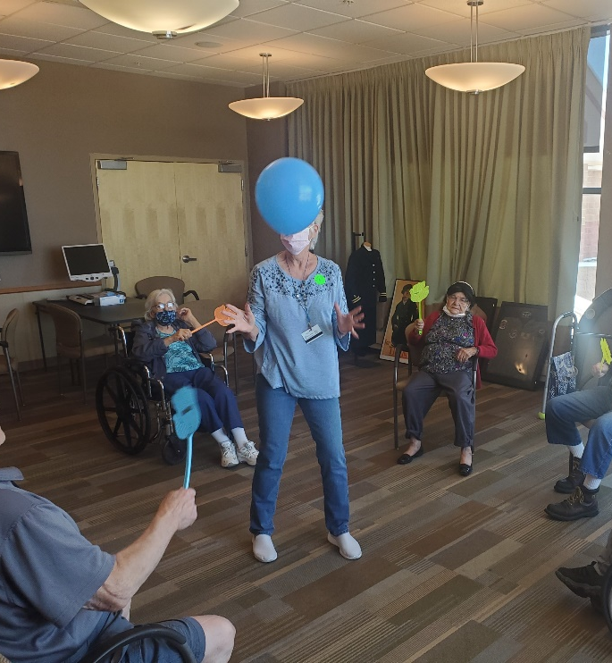
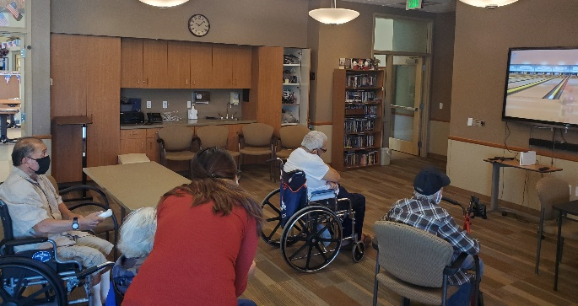
Recent Activities

Slide 17
CNO Report
Kelea Nardini, MSN, RN

Slide 18
CNO Update
Clinics
Outreach/Family Planning moving
Acute/ECU/ED
No new updates
Lab
No new updates
RT
No new updates
Radiology
New Director-Shawna Chamberlain
EMS
New ambulance made its first run on 07/13/21 at 10:37am
Pharmacy
Continue to work with Vizient on Proforma for retail pharmacy
Surgical Services
Dr. Vijan, general surgeon, will start in October

Slide 19
CFO/COO Report
Colette Martin

Slide 20
CFO/COO Activities
IT
Policy Program
WebPT Implementation - COMPLETE
ACCESS Implementation (on hold pending Meditech)
Finance Team
Electronic Payments to Vendors
Added Security
Quick Payments

Slide 21
Materials Management
Materials/Purchasing
New Staff – Erminio Neil
Implementing Handhelds

Slide 22
Meditech Expanse
Kick Off Meeting Scheduled – July 26
Interface Discovery Scheduled – August 2nd
IT Integration – in process
Field Trip to San Luis Valley - TBD

Slide 24
Financial Committee Report
July 22, 2021
Lola Spradley, Treasurer

Slide 25
Financial Statements Summary

Slide 26
Volumes Trending

Slide 27
Volumes Trending

Slide 28
Volumes Trending

Slide 29
Volumes Trending

Slide 30
Questions…

